Slide 1
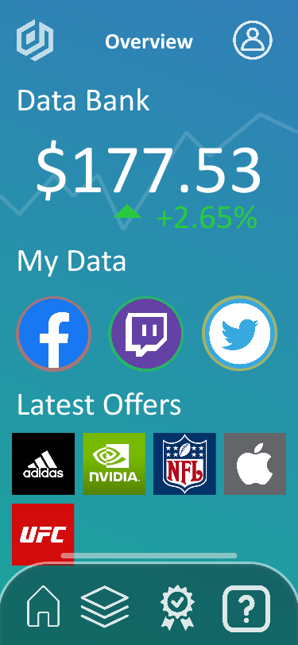
Easily access your data from top bar and add new sources
Access to profile, app settings, and profile settings
Overview serves as the home page and a snapshot of a user’s most interesting information
Displays an estimate of the value of a user’s data. Data’s value decays over time and this should reflect that decay and encourage the user to update their data or upload new data (value increases as a result)
Colored halos around social icons demonstrate whether data is needed (red is bad, green is good, etc)
Sliding tray for icons and quick access to Beth. Feature Access:
Home
License Portfolio
New Offers
Educational content
Square logos differentiate brands from round social media logos; this should funnel users into offers as much as possible

Slide 2
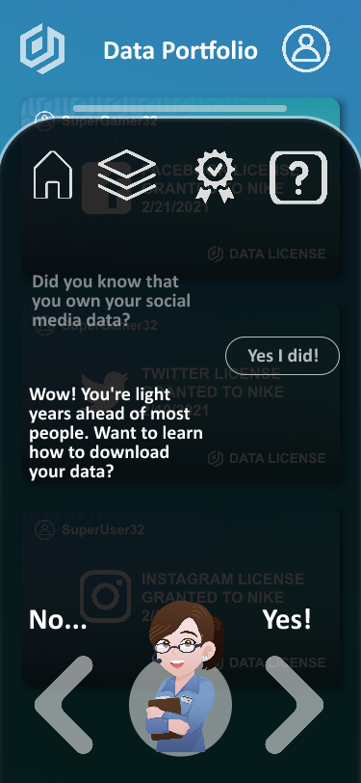
Easily access your data from top bar and add new sources
Access to profile, app settings, and profile settings
Swipe up to reveal tray for icons and quick access to Beth
Feature Access:
Home
License Portfolio
New Offers
Educational content
Click on a previous submission to change it and get a new response from Beth
Interactive chat history with Beth, includes tutorial and any onboarding, allows quick-resume from any process
Beth sits in Siri’s location to reinforce Ai assistant perceptions. Beth can also be tapped for help at any time.
The user responds by swiping in an intuitive manner.

